Slide 1
Future Tactical Management System
Week 9 - Client Meeting 4

Slide 2
What we have implemented
Manual tracks
Settings module
Track replay
Refactored code

Slide 3
User Stories 1
As a user of the system, I want to be able to manually add stable track to the map by clicking a button on the map, so that I can mark points of interest for myself and/or others. (Complete)(2)
As a user of the system, I want to be able to manually add tracks that move by clicking a button on the map, so that I can make predictions about a track's course of collision. (In Progress)(4)
As a user of the system, I want manual tracks to be coloured according to the military guidelines, so that I am able to differentiate between live and manual tracks. (Complete)(1)
As a user of the system, I want manual tracks that have been added by other users to also be reflected on my screen, so that our work can be synchronised. (Complete)(1)
As a user of the system, I want other users to be able to see manual tracks that I have inserted, so that our work can be synchronised. (Complete)(1)
As a user of the system, I want to be able to delete manual tracks by clicking a button on the track table, so that I can remove unused tracks and clear up space on the map. (Complete)(3)

Slide 4
User Stories 2
As a user of the system, I want to be able to save customised layouts of the FTMS interface to my account, so that I can load my preferred layout the next time I log in. (Complete)(4)
As a user of the system, I want to be able to select and load a layout of my choice of the FTMS interface, so that I am able to work with my preferred layout. (Complete)(5)
As a user of the system, I want to be able to turn on a colourblind mode in the settings module, so that I am able to differentiate between the different coloured tracks and alerts if I am colourblind. (Complete)(2)
As a user of the system, I want to be able to turn audio notifications on and off for alerts and messages, so that I am able to hear when a new alert or message has come through. (Complete)(1)
As a user of the system, I want to be able to switch between dark and light interface themes in the settings module, so that I can work with my preferred interface. (Complete)(2)
As a user of the system, I want to be able to adjust track icon sizing in the settings module, so that I can make changes to track icons according to my preferences. (Complete)(1)

Slide 5
User Stories 3
As a user of the system, I want to be able to playback previously-shown tracks so that I may review past events. (In Progress)(5)
As a user of the system, I want to control track replay from a track replay module, so that it does not interfere with other parts of the system. (Complete)(1)
As a user of the system, I want to be able to specify a start and end time for the track replay mode. (Complete)(2)
As a user of the system, I want to be able to switch between live tracks and track replay through the use of a slider. (In Progress)(3)
As a user of the system, I want to be able to play, pause and rewind the replay of the tracks. (In Progress)(3)
As a user of the system, I want to be able to use a scrub bar (scrubber/seek bar) to change the point in time I am viewing in the track replay, so that I have a familiar interface I can use. (In Progress)(1)

Slide 6
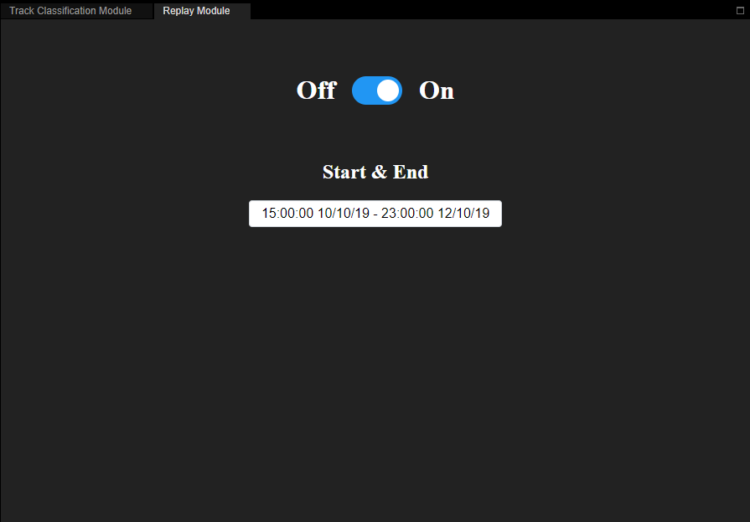
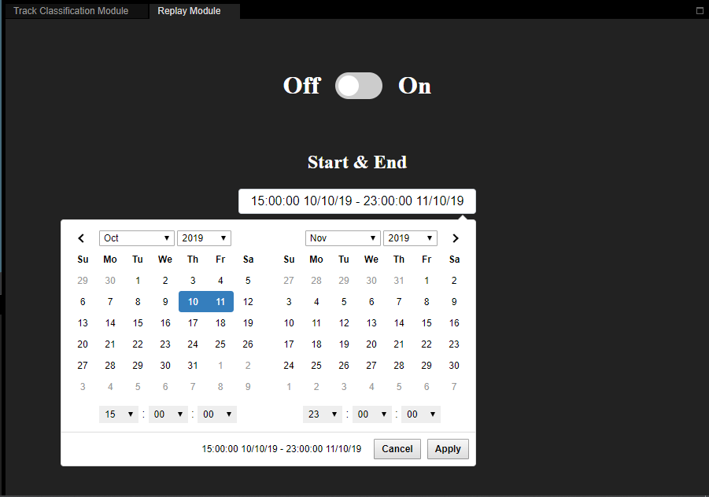
Replay UI
Notes:
Can place this before or after user stories?
Is this what you’ve done so far?
Yeah, I don’t have a demo as none of the server side is done so I just want to show off my UI and check if it’s good
Yep sure we’ll put it after ur slide for user stories
Cheers, be there soon
See you soon

Slide 7
What we will work on next sprint
As a user of the system, I want changes I make to my settings to be saved to my account, so that I do not have to reconfigure my settings each time I log in. (3)
As a user of the system, I want my saved settings to be automatically loaded the next time I log in, so that I am able to work with my preferred settings. (3)
As a user of the system, I want to be able to focus the map on ownship so that I can keep track of my surroundings as it moves. (3)
As a user of the system, I want to have a button to toggle in and out of the map’s ownship focus, so that I can look around the map freely when I need to. (3)
As a user of the system, I want to be able to see the current zoom level of my map, so that I can see how far in or out the map is zoomed. (2)

Slide 8
What we will work on next sprint
As an administrator of the system, I want to be redirected to a dashboard when I login with the correct credentials, so that I may carry out my admin activities. (3)
As an administrator of the system, I want to be able to register users to the system via an admin dashboard, so that they are able to access the system with the correct privileges. (3)
As an administrator of the system, I want to be able to create user roles and decide which modules they are able to access via an admin dashboard. (4)
As an administrator of the system, I want to be able to change which modules existing user roles can have access to via an admin dashboard. (4)
As an administrator of the system, I want to be able to view a table of all users of the system and their details (username, role, last active, ip address). (3)

Slide 9
What we will work on next sprint
As an administrator of the system, I want to see tallies of the total number of users, firing officers, warfare officers, and tracking supervisors on the admin dashboard. (3)
As an administrator of the system, I want changes I make to a user’s privileges to be reflected on the user’s FTMS interface window, so that our work can be synchronised. (2)

Slide 10
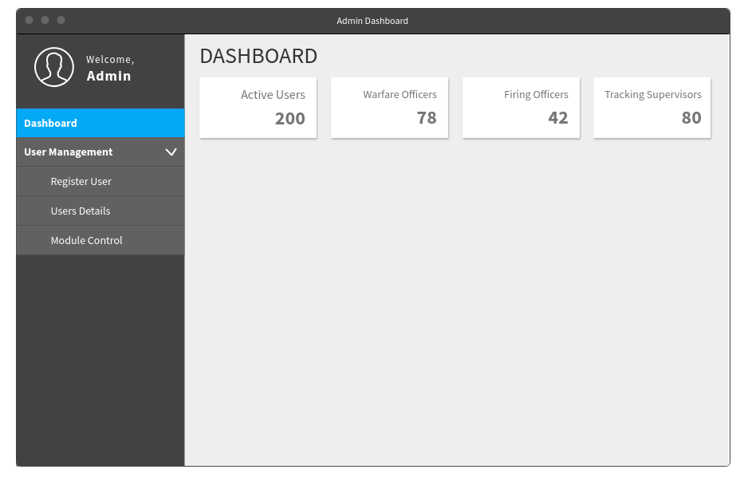
~ Admin Dashboard Mockups

Slide 11
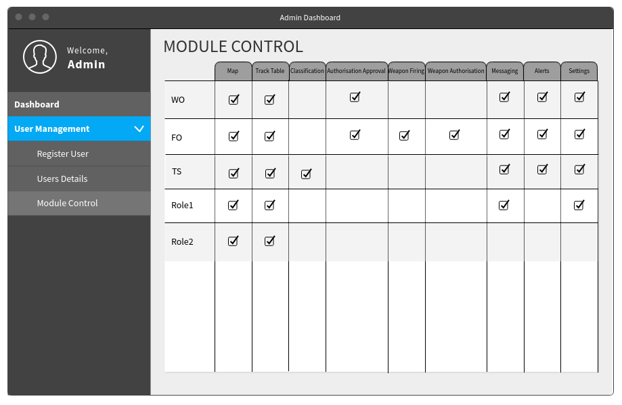
~ Admin Dashboard Mockups

